Slide 1


ONLINE SHOPPING SENTIMENT ANALYSIS -FLIPKART
SUMMER INTERNSHIP-2 PRESENTATION ON
Prof.Vidya Sagar
Dept. of AIML
KNSIT
Presented by
Farha Kousar
1KN21AI010

Slide 2
Contents
Abstract
Introduction
About the company
Block Diagram
Block Diagram Explanation
Hardware, Software Requirements
Applications
Conclusion
References

Slide 3
Abstract
E-commerce is rising rapidly now a days, purchasing items on online has grown to be more and more fashionable outstanding of more options like lower in price, better supply system, therefore buyers plan to do Online shopping.
User's comments are useful information to estimate product quality. This paper has a tendency to analyze the fundamentals of opinion mining. It consist different approaches including Extraction, Clustering and Classification.
Extracting reviews from the website using flipkart product API, using product API we can easily fetch the brand name, reviews, rating and other related things for product, clustering using ROCK and using CART algorithm to classify reviews as positive and negative words from the comments and finally they come to know which product having more percentage of positive reviews.

Slide 4
Introduction
Online Shopping Sentiment Analysis on Flipkart aims to analyze customer reviews, providing insights into user sentiments and preferences on the e-commerce platform.
Python is a high-level, general-purpose programming language to build chatbot,calculator,text to speech,speech to text etc.
The project involves applying data science techniques with Python, enabling the analysis and interpretation of data to extract valuable insights that support decision-making processes.
Jupyter Notebook serves as the primary tool for project development, offering a user-friendly interface for Python coding and analysis.
Python libraries like Pandas, Matplotlib, Seaborn, NLTK, and WordCloud are employed for analysis and visualization, enhancing the project's capabilities.

Slide 5
About the company
Established in Bangalore by Babjan.S, Global Core Tech is a leading IT education institute, committed to providing high-quality education and job placement services
The institute offers diverse courses covering programming, software development, web development, database management, and cybersecurity, preparing individuals for successful IT careers.
Global Core Tech provides IT & Non-IT Training, Soft Skills Training, Internships, Academic Projects, and Online Courses to equip students with the skills demanded by the industry.
Hands-on learning experience, Opportunity for growth, Mentorship and guidance, Innovation and creativity, Challenging and rewarding.

Slide 6

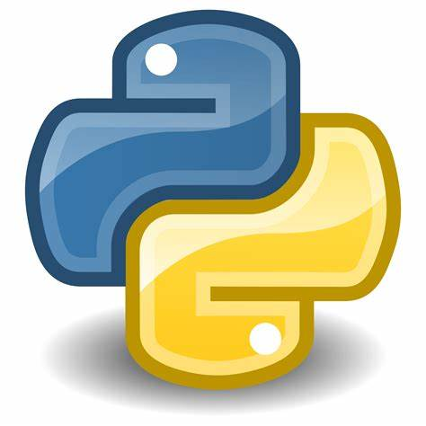
PYTHON PROGRAMMING
Python is a popular programming language.
Python is a high-level, general-purpose programming language.
It was created by Guido van Rossum, and released in 1991.
The biggest strength of Python is huge collection of standard library .
Python is simple and so easy to learn.
It supports functional and structured programming methods as well as OOP.
python programming can enable to interact the hardware like ardunio by specifies the software .

Slide 7
Data science with Python
Data Science with Python involves collecting and processing data from various sources.
Data science is the field of extracting insights and knowledge from data to make informed decisions.
Python is a versatile and beginner-friendly programming language widely used in data science due to its simplicity and a rich ecosystem of libraries.
Pandas is a key library for handling and organizing data in tables, making tasks like cleaning, transforming, and analyzing data straightforward.
Matplotlib helps visualize data through various plots and charts, enabling a better understanding of patterns and trends.
Seaborn builds on Matplotlib, offering a simplified interface for creating aesthetically pleasing statistical graphics.
NLTK is a toolkit for working with human language data, facilitating tasks like text cleaning, tokenization, and sentiment analysis.
WordCloud is a tool for creating visually appealing representations of word frequency in text data.

Slide 8
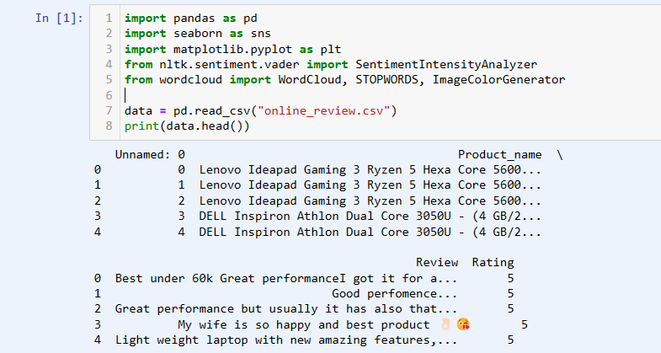
Online Shopping Sentiment Analaysis
Sentiment analysis of online shopping experiences on Flipkart, evaluating customer emotions and opinions.

Slide 9
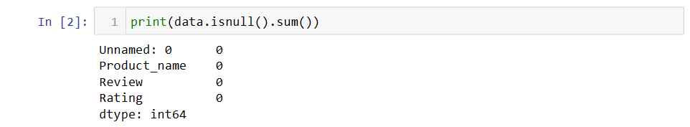
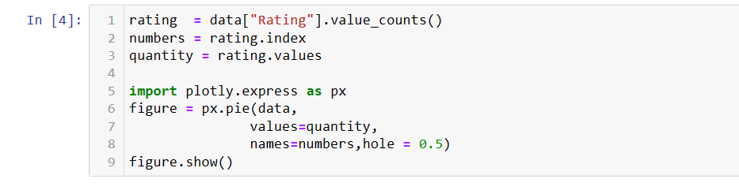
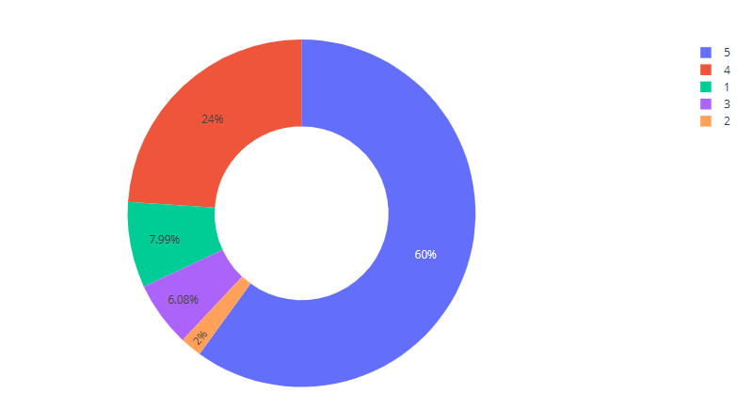
Online Shopping Sentiment Analaysis-Flipkart Rating visualization code:

Slide 10
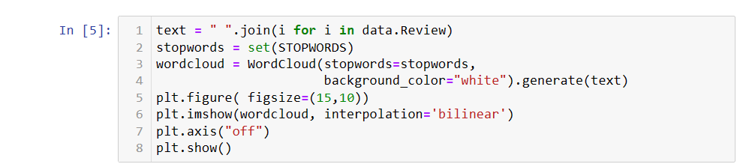
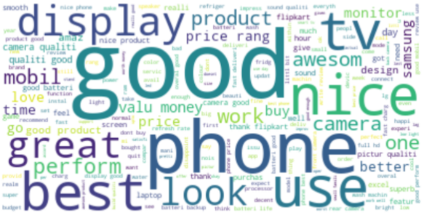
Online Shopping Sentiment Analaysis-Flipkart
wordcloud of reviews code:

Slide 11
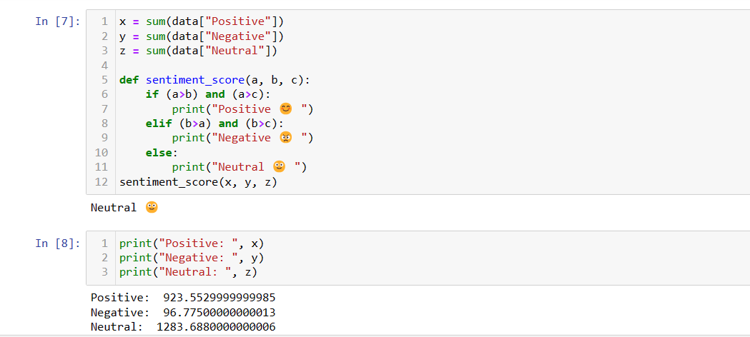
Online Shopping Sentiment Analaysis-Flipkart
Reviews Rating score

Slide 12
Software Requirements
Scripting language : Python Programming
Scripting Tool : Anaconda Navigator (Jupyter Notebook)
Operating System : Microsoft Windows 7, 8 or 10
Dataset: online_review.csv
Machine Learning Packages : Pandas, Matplotlib , Seaborn ,nltk,wordcloudetc..

Slide 13
Hardware Requirements
Processor : 3.0 GHz and Above
Output Devices : Monitor (LCD)
Input Devices : Keyboard
Hard Disk : 1 TB
RAM : 8GB or Above

Slide 14
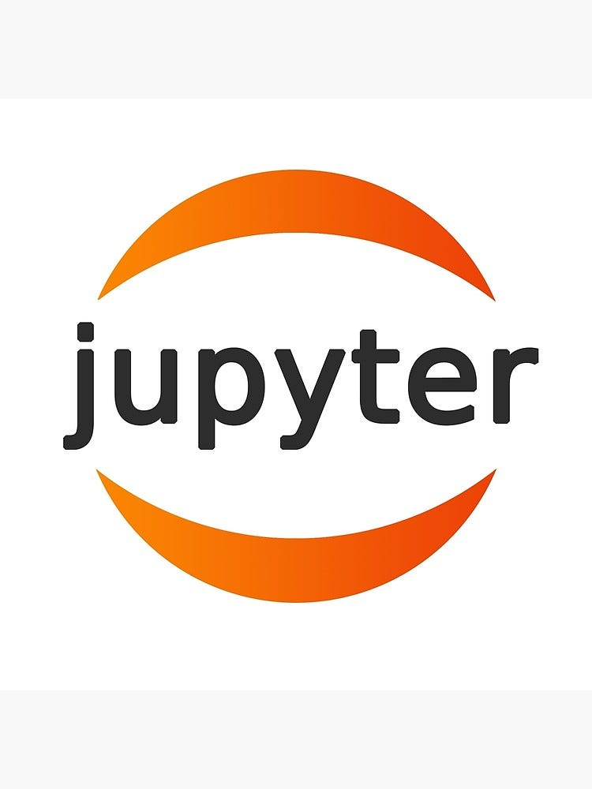
Jupyter Notebook
Introduction to Jupyter Notebook:
Versatile web-based coding environment.
User-friendly interface for interactive computing.
Supports various languages, including Python.
Utilizes a cell-based structure for iterative coding.
Project Application - Online Shopping Sentiment Analysis:
Analyzes customer reviews on Flipkart.
Uses Python and libraries like Pandas, Matplotlib, Seaborn, NLTK.
Extracts data through the Flipkart product API.
Classifies sentiments through clustering and classification algorithms.

Slide 15
Conclusion
Most of the reviews are in favor of Neutral.
The Negative review score has a small proportion, and Positive reviews are midway.
Ultimately benefit present and future customers and e-commerce companies.
Sentiment analysis is important because, based on bad reviews, the e-commerce company make
Those products better or replaces those products with better and newer ones, which ultimately

Slide 16
Reference
Learning Python by Mark Lutz : O’Reilly Publication 4th Edition https://cfm.ehu.es/ricardo/docs/python/Learning_Python.pdf
•Data Science Theories, Models, Algorithms and Analytics by S. R. Das -https://srdas.github.io/Papers/DSA_Book.pdf
•Python Primer by Dirk P. Kroese - https://people.smp.uq.edu.au/DirkKroese/DSML/DSML.pdf

Slide 17
THANK YOU

